Slide 1
Unit : 1 Topic : “Basic Docker Commands”

Slide 2
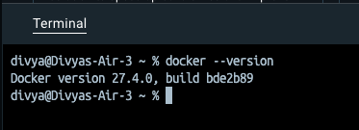
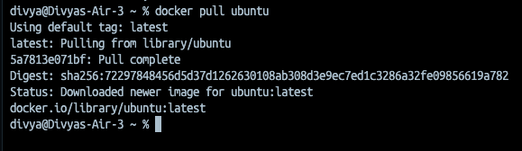
1. Check Docker Installation: docker --version
2. Pull an Image : docker pull imageName

Slide 3
Serach for available images :
docker search imagename

Slide 4

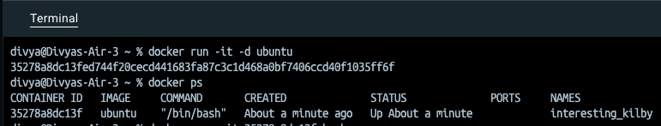
3. List Downloaded Images : docker images
4. Run a Container and list all containers :
docker run -it -d ubuntu { it : interactive mode & d : detached mode}

Slide 5
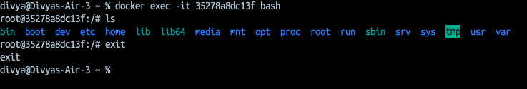
List all containers :
docker ps : { Shows currently running containers
docker ps -a : {To list all containers (including stopped ones)
Access the running container’s shell. :
docker exec -it container-id bash
ls : to list contents of container
exit : to exit the container

Slide 6
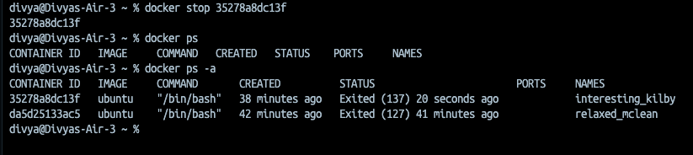
Stop a Container :
docker stop container_id { stop a container}
docker ps : { to list all running containers}
docker ps -a : { list all containers including stopped containers }
docker start container_id : { start a stopped container}

Slide 7
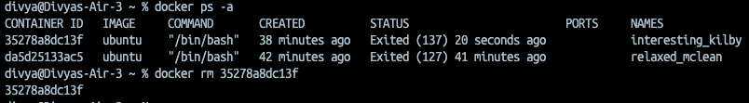
Remove a container :
docker rm container_id

Slide 8
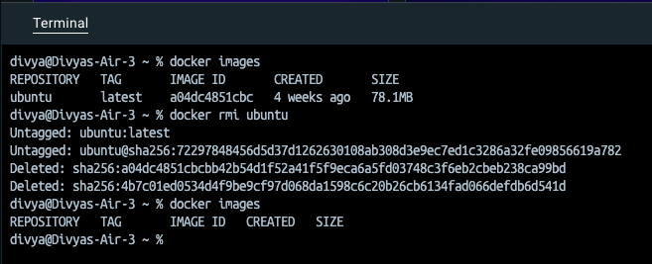
Remove images :
docker rmi imageName {remove image }

